Slide 1

Myers-Briggs Personality Prediction
Nalisha Rathod (GS9440)
Sujata Gorai (hc6837 )

Slide 2
Agenda
Introduction
Related Works
Dataset
Methodology
Experiments and Results
Conclusion

Slide 3

About the Data set
The Myers Briggs Type Indicator (or MBTI for short) is a personality type system that divides everyone into 16 distinct personality types across 4 axis:
Introversion (I) — Extroversion (E)
Intuition (N) — Sensing (S)
Thinking (T) — Feeling (F)
Judging (J) — Perceiving (P)
The purpose of this project is to investigate if any patterns can be detected in a person’s specific personality type in connection to their style of writing and to explore the validity of the test in analyzing, predicting, or categorizing behavior.

Slide 4

MBTI Dataset
The dataset contains 8600 observations (people), where each observation gives a person’s:
Myers-Briggs personality type (as a 4-letter code)
An excerpt containing the last 50 posts on their PersonalityCafe forum (each entry separated by “|||”)

Slide 5
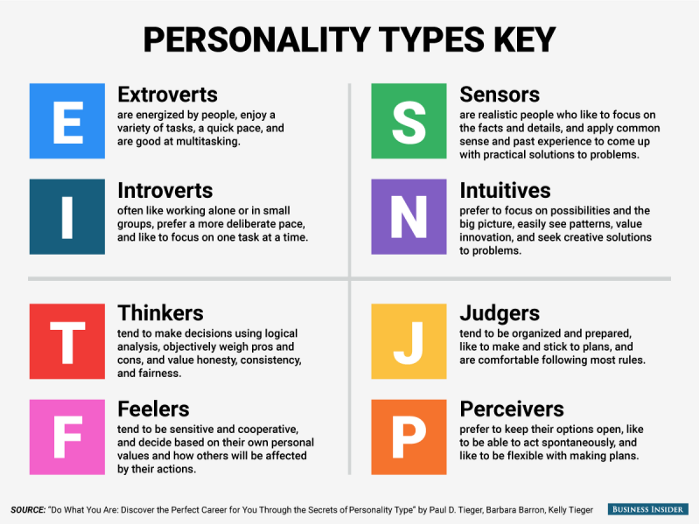
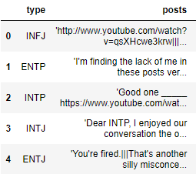
Dataset

Slide 6
Data Preprocessing
Several methods to preprocess the comments before passing to the training model.
Replaced "|||" from text with " " Join all texts written by 1 Person
Removed Links from text and replace them with 'Link'
Removed punctuation from Text

